Slide 1
Tata Virtual Experience Program
Data Visualisation: Empowering Business with Effective Insights

Slide 2
Online Retail Platform
Sales Insights and Analysis

Slide 3
Task – 1
The CEO wants to examine the revenue data for the year 2011.
This means breaking down the revenue figures and observing the performance for each month individually and understanding the seasonal trends.

Slide 4
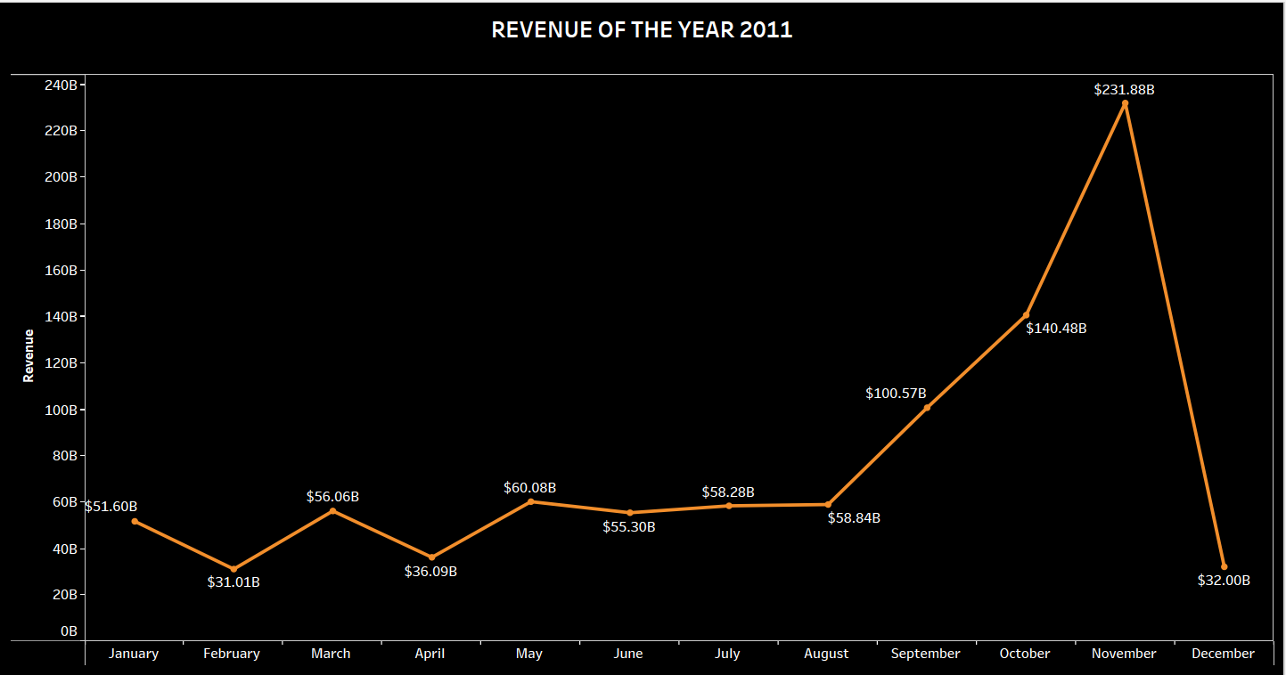

Slide 5
Task - 2​
The CMO wants to determine the Top 10 countries that generate the highest revenue for the retail store along with the quantity sold.

Slide 6
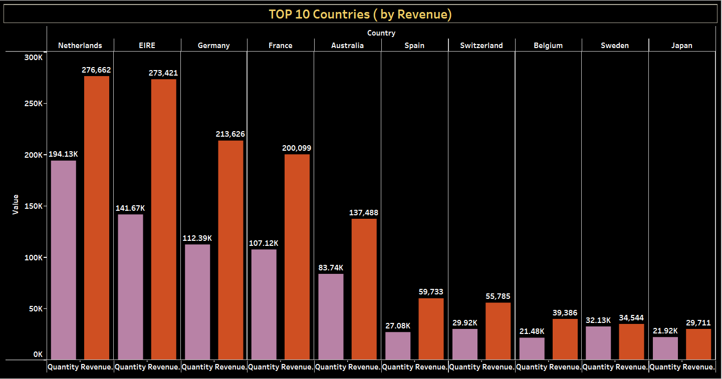

Slide 7
Task - 3​
The CMO of the online retail store wants to view the information on the top 10 customers by revenue. ​

Slide 8
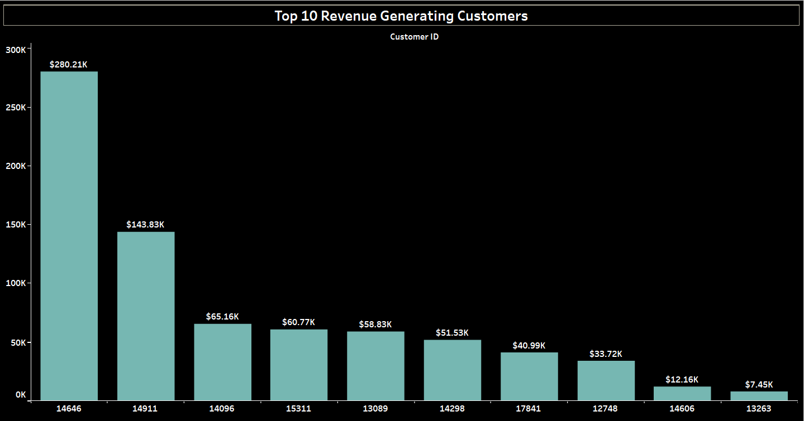

Slide 9
Task – 4
The CEO wants to gain insights into the demand for their products across different regions and identify areas with high demand potential.

Slide 10
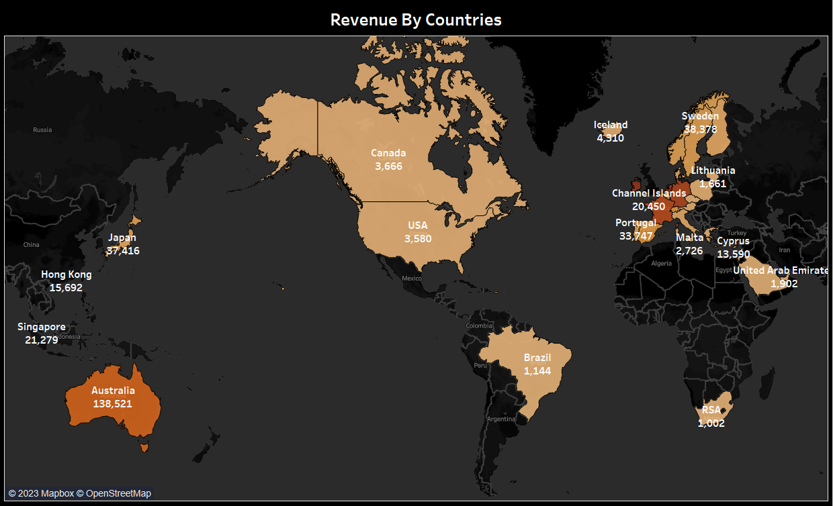

Slide 11
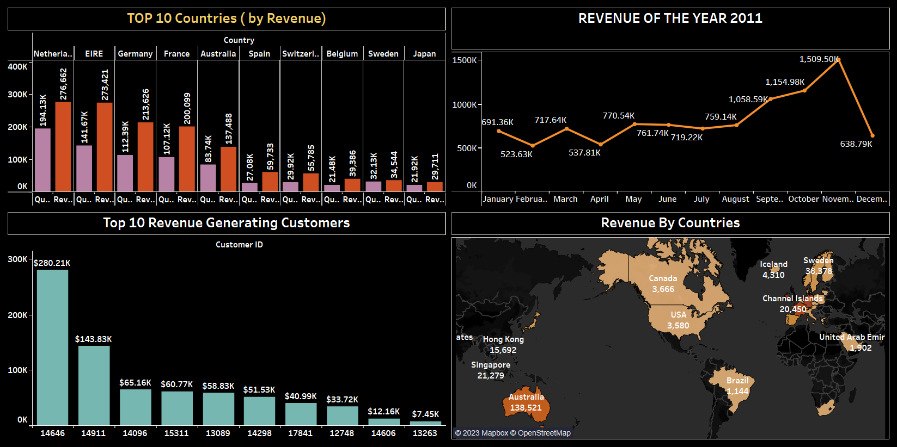

Slide 12
Thank you !!

